Slide 1
Using HMIS data for COVID-19 Surveillance
A short course: Lecture 1

Slide 2
Background and Overview

Slide 3

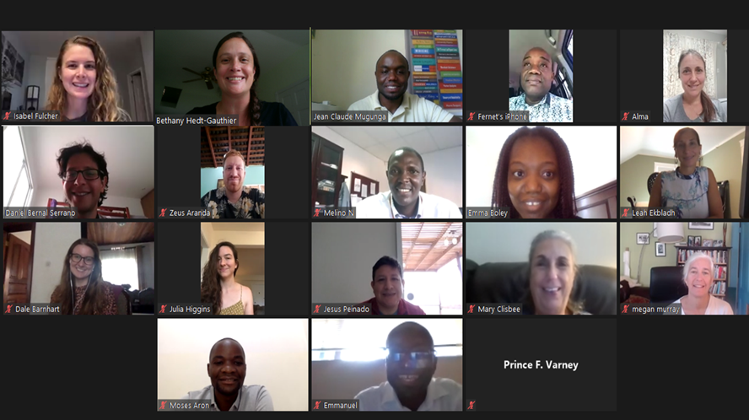
Cross-PIH site collaboration
Identify the core and common questions.
Develop rigorous methods that are contextually appropriate to answer these questions.
Work collaboratively to implement, and share results and lessons learned across sites.

Slide 4
Core common questions
What is the burden of COVID-19?
How is COVID-19 directly affecting health, particularly in high-risk groups?
How is COVID-19 affecting care and outcomes across the health system?

Slide 5
How can we leverage routinely collected data to improve COVID-19 response?
Syndromic Surveillance
Health Service Utilization
What regional areas have a higher than expected increase in the number of patients with COVID-19-associated symptoms?
How do the number of individuals receiving care during the COVID-19 pandemic compare to what is expected?
The methods for routine monitoring will involve identifying “deviations” from what is expected for further investigation.
Notes:
There are TWO goals of this activity.
The first goal is to assessing the direct impact of COVID19 through syndromic surveillance. This involves using data on symptoms or outcome directly related to COVID-19 to flag geographic areas for potential COVID-19 circulation. This does not use information on positive COVID-19 tests, but instead uses information on symptoms, such as pneumonia or flu-like symptoms, to identify hotspots.
The second goal is to quantify the indirect impacts of COVID19 on utilization of essential health services, which range from assessing changes in the number of outpatient visits to the number babies delivered in a health facility to the number of children receiving their immunizations.
Despite being two distinct goals, these goals do share the fact they BOTH use routinely collected data and look for deviations from what is “expected”. And so, the data science tools that we use will be similar.

Slide 6
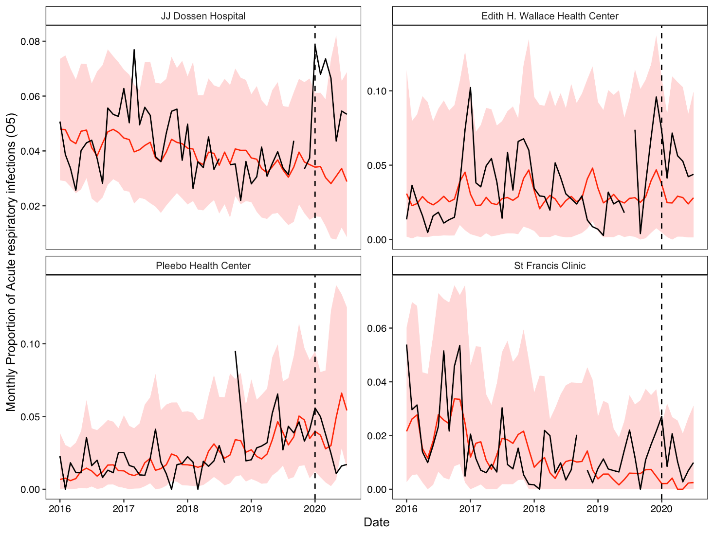
Increased in ARI cases at 3 PIH-supported facilities in Maryland County for ages ≥5 years
Higher proportions of ARI cases were also observed at JJD, Edith Wallace and St. Francis late 2019 into early 2020 at these 3 PIH-supported facilities in Maryland County for individuals 5 years or older.
Red: predicted visits based on prior data with 95% prediction intervals
Black: observed visits
Dotted line: Extrapolation period begins
Credit: Emma Boley, Izzie Fulcher

Slide 7
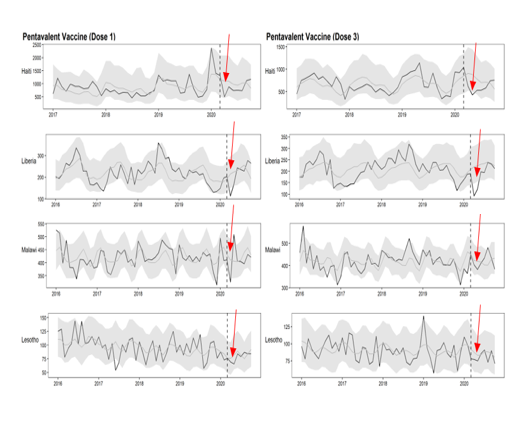
Steeper reductions observed in Pentavalent in Haiti, Liberia & Malawi early in 2020
We observed reduce pentavalent vaccination coverage for both doses (1 & 3), but reduction was not sustained!
Credit: Emilia Connolly, Emma Boley, Izzie Fulcher

Slide 8

Resources

Slide 9
Goals of this course
Overview of the course: The goal of this course is to better understand the methods used for syndromic surveillance and health service utilization monitoring, as applied to HMIS/DHIS2 data in the context of the COVID-19 pandemic. By the end of the 5-session course, we expect participants to know the process of creating these models and can understand and more confidently explain how to interpret the results.

Slide 10
Goals of this course
The specific objectives are:
To identify indicators most relevant for these purposes.
To describe and interpret the models used to a) establish a baseline; b) assess higher or lower levels than expected during the pandemic.
To understand the data processing pipeline - from receipt of indicator data to production of figures.
To interpret results from the various visualizations of the data and results.
(Optional, for those with background in statistics and R) To be able to implement the data cleaning, modeling and visualization process in R.
Structure:
5 weeks
First 1-1.5 hours, lecture and discussion
Second 1.5-2 hours, practice (in R)

Slide 11
Acknowledgements
Other Collaborators:
Zeus Aranda
Moses Aron
Thierry Binde
Peterson Abnis I Faure
Karen Grepin
Nadine Kareema
Meba Msuya
Megan Murray
Prince Varney
Tech support:
Don Fejfar
Anuraag Gopulani
Nichole Kulikowski
Ananya Tadikonda
Kate Tashman
Jessica Wang
CIHR Grant
Co-PIs:
Bethany Hedt-Gauthier
Mike Law
Co-Is:
Isabel Fulcher
Emma Boley
Emilia Connolly
Chiyembekezo Kachimanga
Fred Kateera
Jeune Marc Antoine
Melino Ndayizigiye
Daniel Serrano

Slide 12
Selecting indicators

Slide 13
What is an indicator?
An indicator is a quantitative metric that can be used to:
Monitor uptake
Assess achievement
Provide warnings
Indicators should be well-defined and consistently measured.
For this project, we are limiting to indicators available in health management information systems (HMIS) and for many places, specifically captured in DHIS2.

Slide 14
COVID-19 Surveillance
Ideally, we would monitor COVID-19 directly.
What indicators are countries using to look directly at COVID-19?
Why is it not always possible to use these indicators to monitor COVID-19?

Slide 15
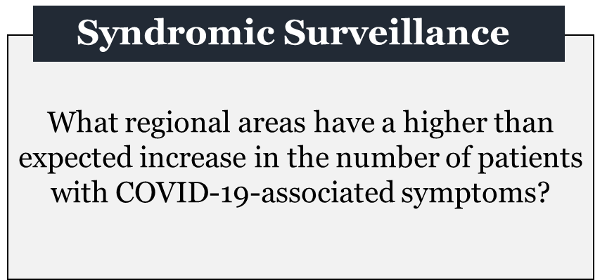
Syndromic surveillance
Monitor disease symptoms rather than the disease itself.
Not as good as monitoring the disease itself.
May give indicators of where disease is present, if it is difficult to monitor directly.

Slide 16
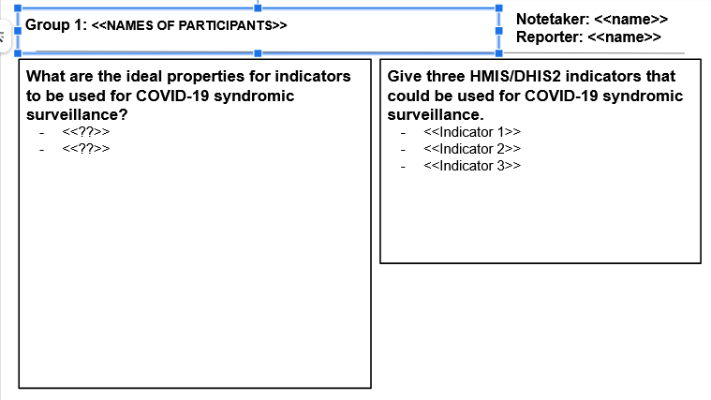
Group work
In small groups (3-4 people), discuss:
What are ideal properties for indicators to be used for syndromic surveillance?
Three indicators for COVID-19 Sruveillance.
10 minutes.
Designate a notetaker and someone to report back.
Notes:
https://docs.google.com/presentation/d/1aQ_OAYSbnvk0bWnosfPtf5EA517R3yfuZT0QgSs52eA/edit#slide=id.gc176dbddcc_0_0

Slide 17
Properties of a COVID-19 SS indicator

Slide 18
Recommended indicators

Slide 20
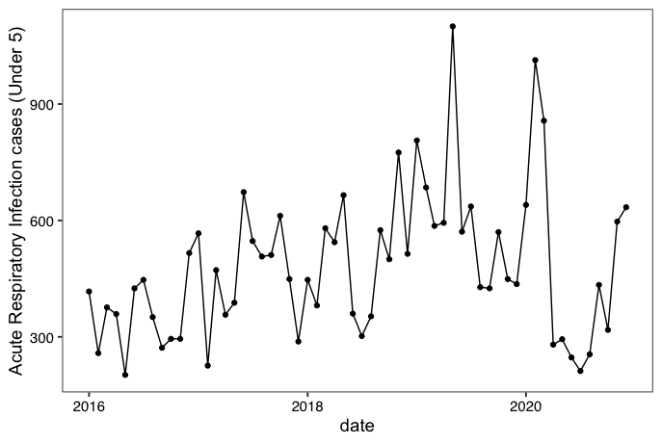
Acute Respiratory Infection cases among children (under 5) for Neno District Hospital

Slide 21
Health service utilization indicators
Assess uptake of essential health services.
Compare uptake to “expected”.
Assessment of reasons for changes.
Targeted interventions to address any deficits.

Slide 23
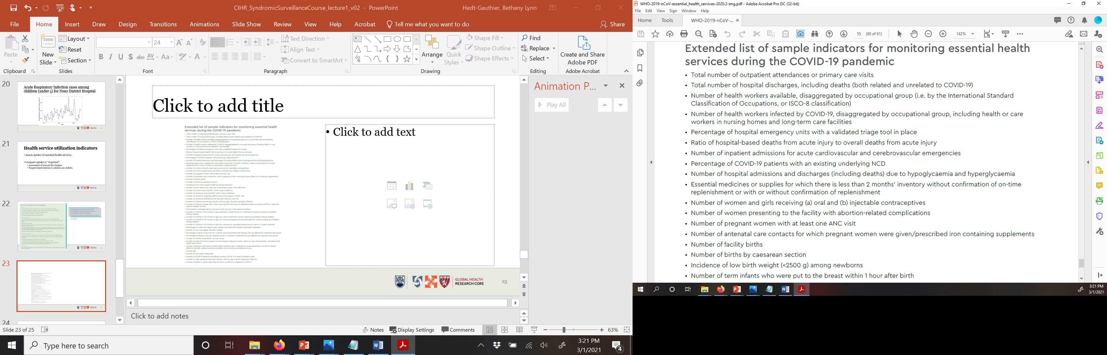
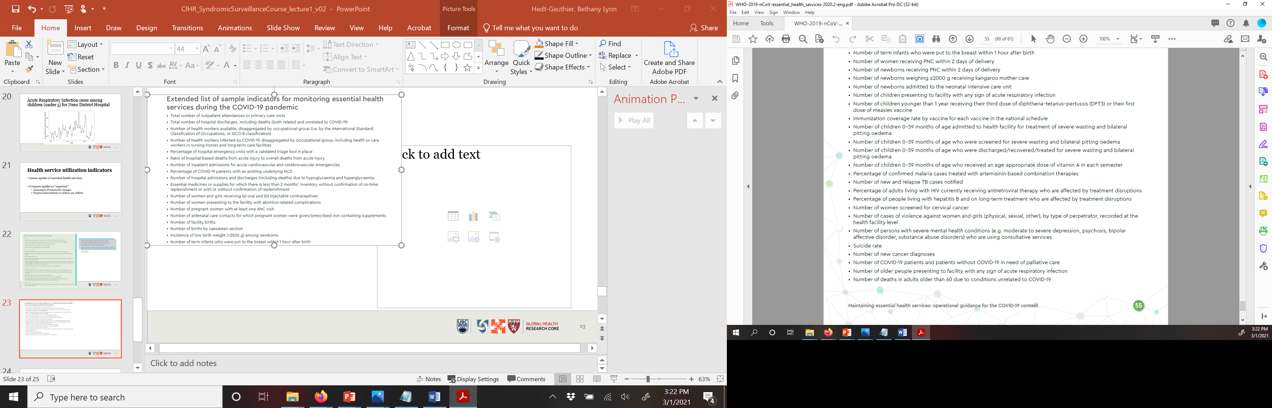

Slide 24
What about service utilization indicators?
Which of the ideal properties remain true when looking at HSU indicators?
Are there any different considerations when selecting HSU indicators?

Slide 25
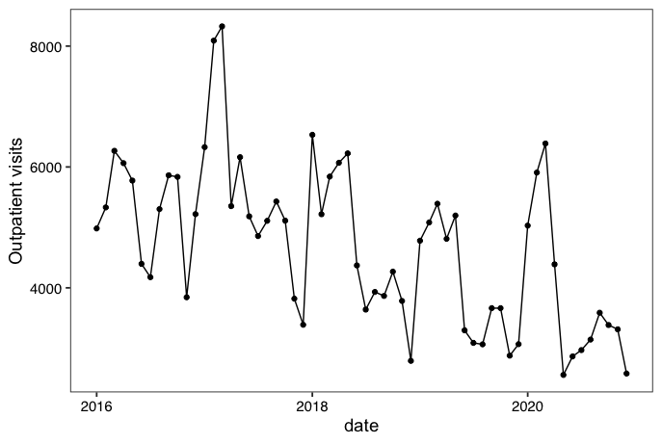
Outpatient visits for Lisungwi Health Centre

Slide 26
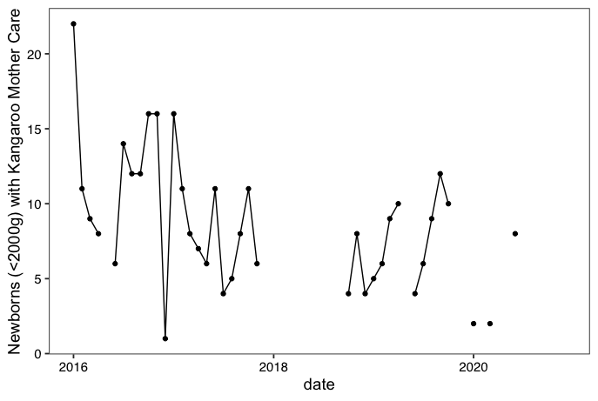
Kangaroo Mother Care indicator for Neno District Hospital

Slide 27
What’s next?
Today’s lab: Importing data and producing plots.
Week 2: Building basic time series models
Week 3: Determining expected and comparing to observed
Week 4: Data processing
Week 5: Visualizations

Slide 28
Questions?

